Slide 1
Survey

Slide 2
Categories
Random Walks
Graph kernels
Attention based methods
Others

Slide 3
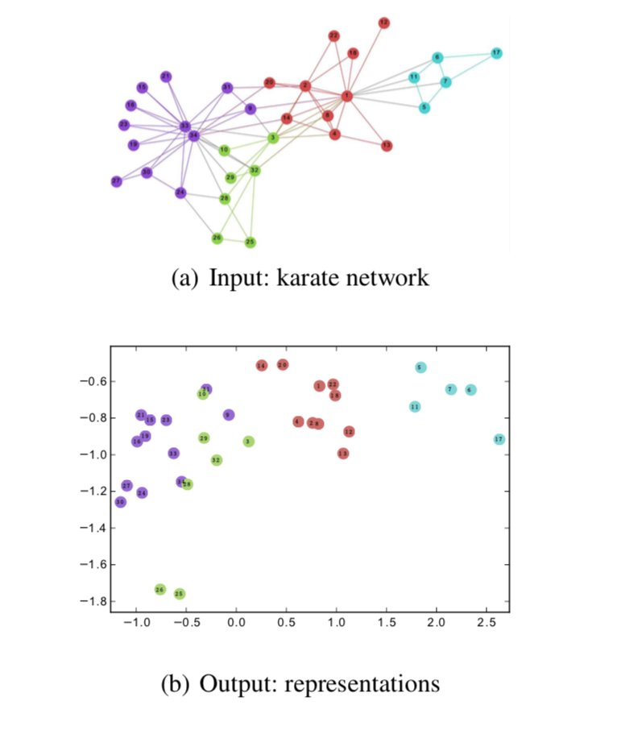
Random walks
Power law distribution
Graph--node seqences
node seqences--word seqences
skip-gram model

Slide 4
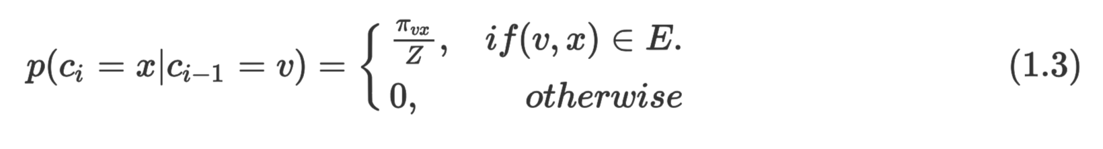
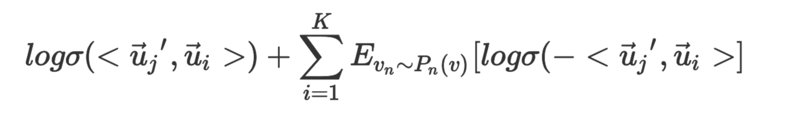
Random walks
deep walk

Slide 5
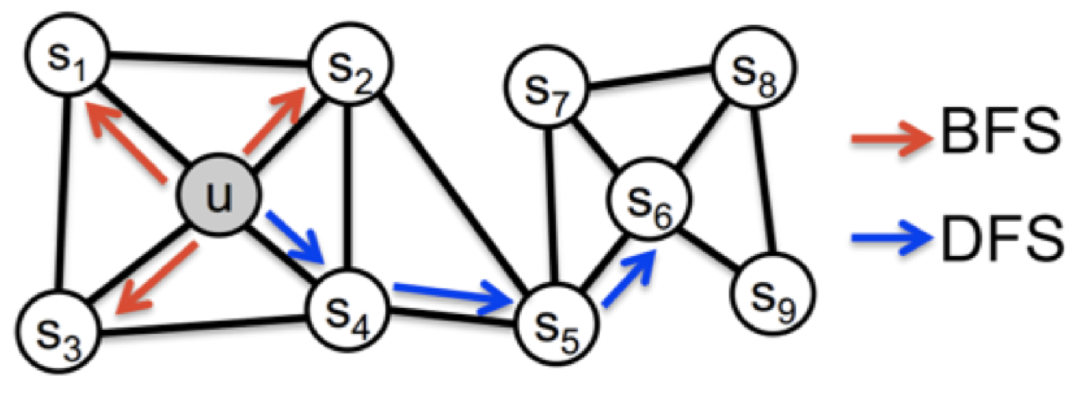
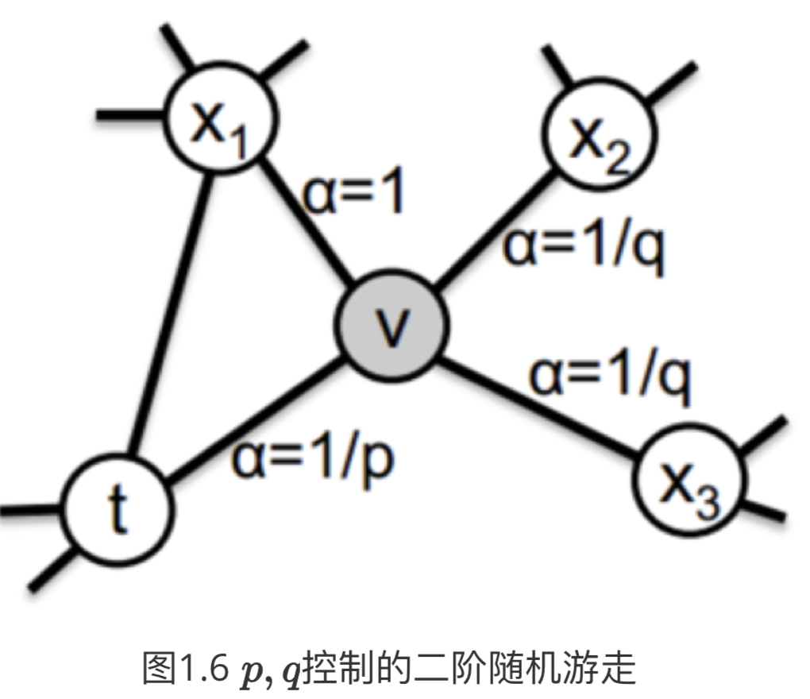
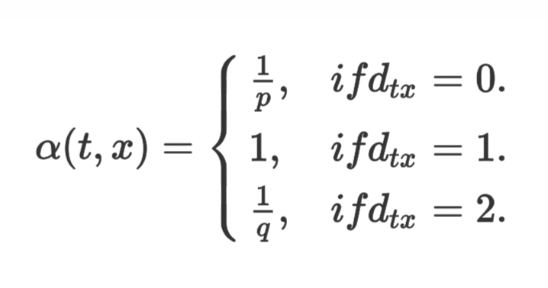
Random walks
node2vec

Slide 6
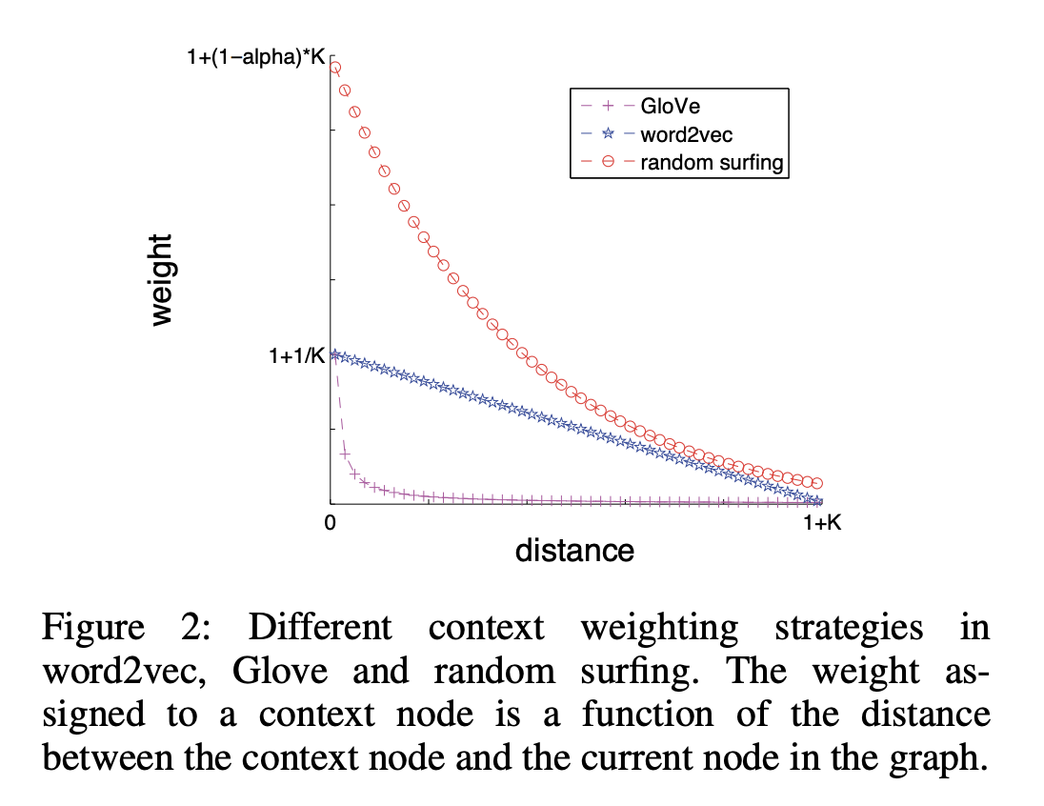
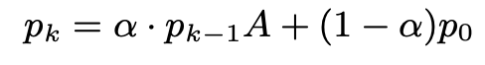
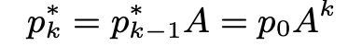
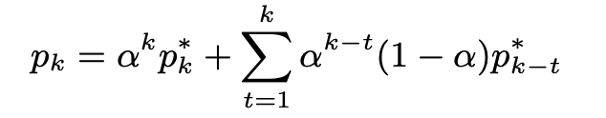
Random walks
random surfing
different context weight strategy

Slide 7
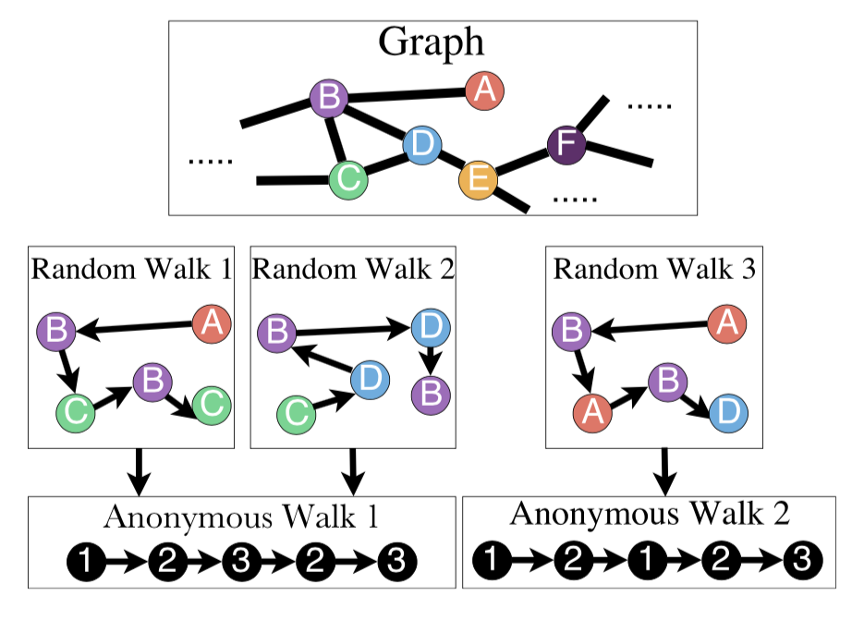
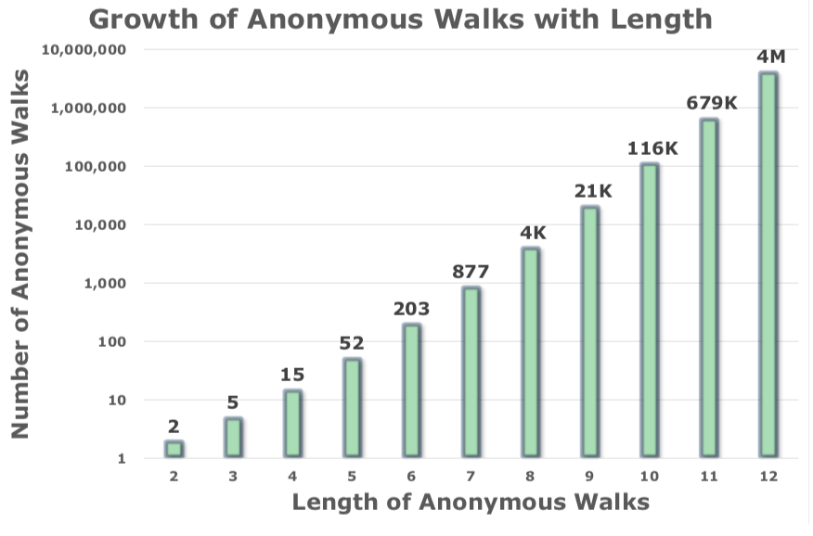
Random walks
Anonymous walk

Slide 8
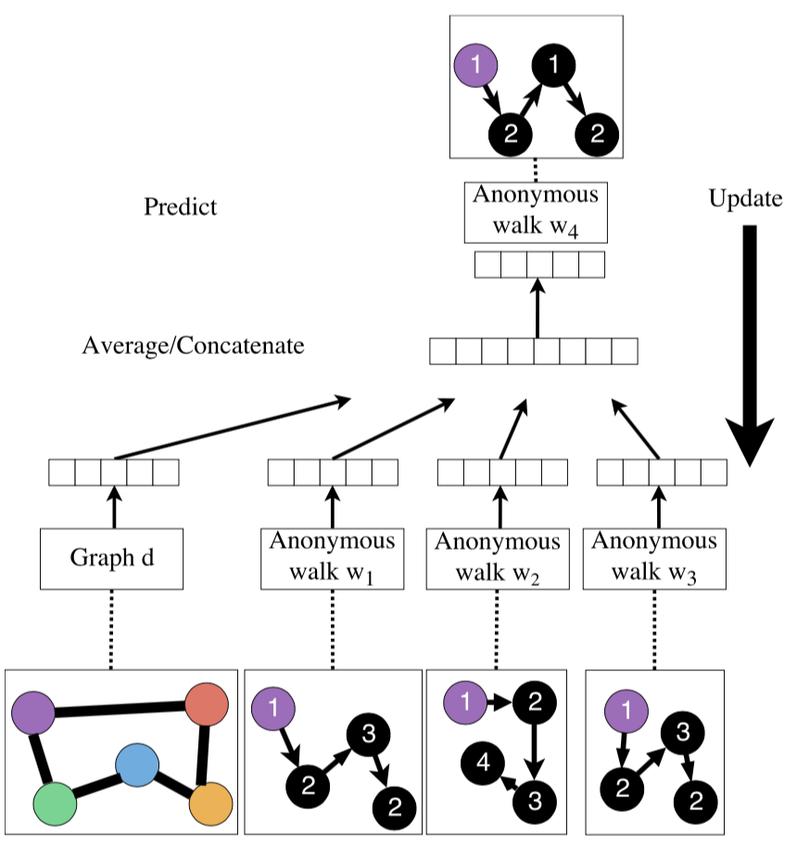
Anonymous walk optimization

Slide 9
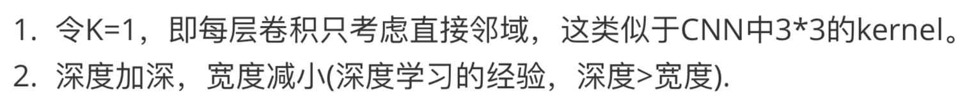
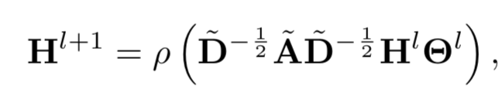
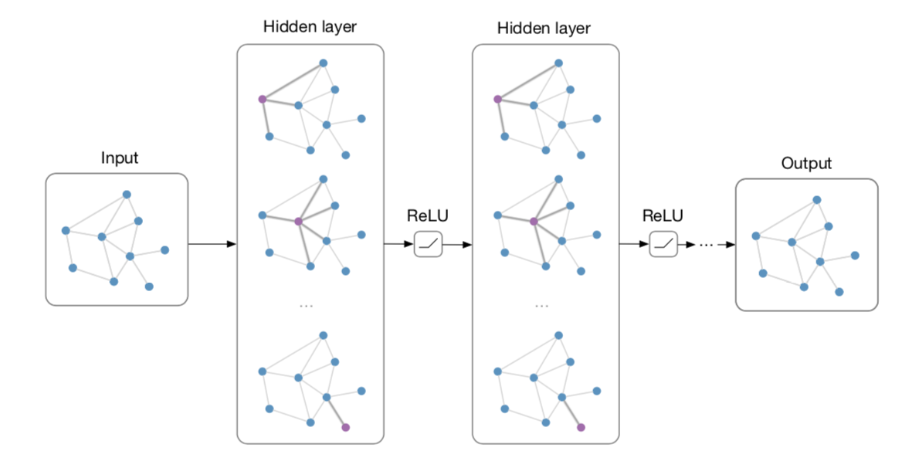
Graph kernels
Graph convolutional networks

Slide 10
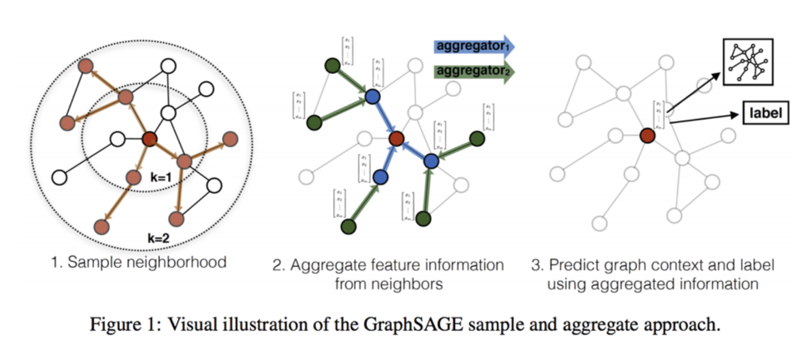
Graph kernels
Graphsage

Slide 11
Graphsage
Aggregators
Mean aggregator:
LSTM aggregator:
Max-pooling aggregator:
GCN aggregator

Slide 12
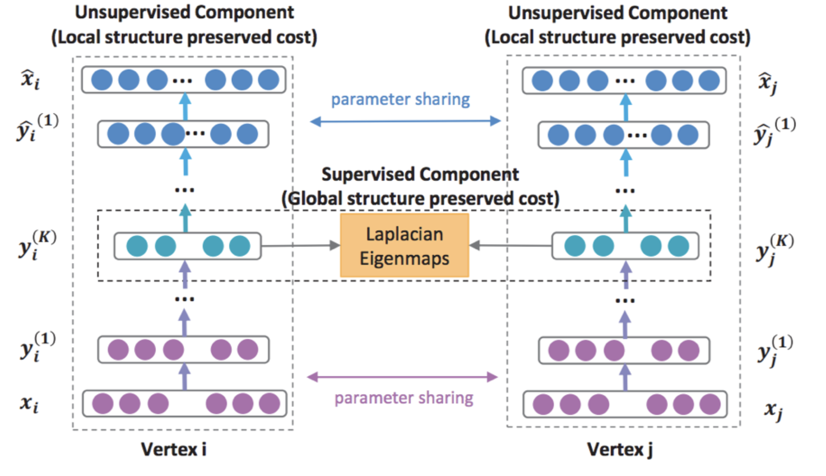
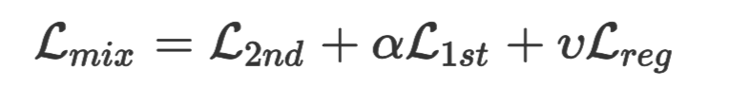
Graph kernels
Deep auto-encoder

Slide 13
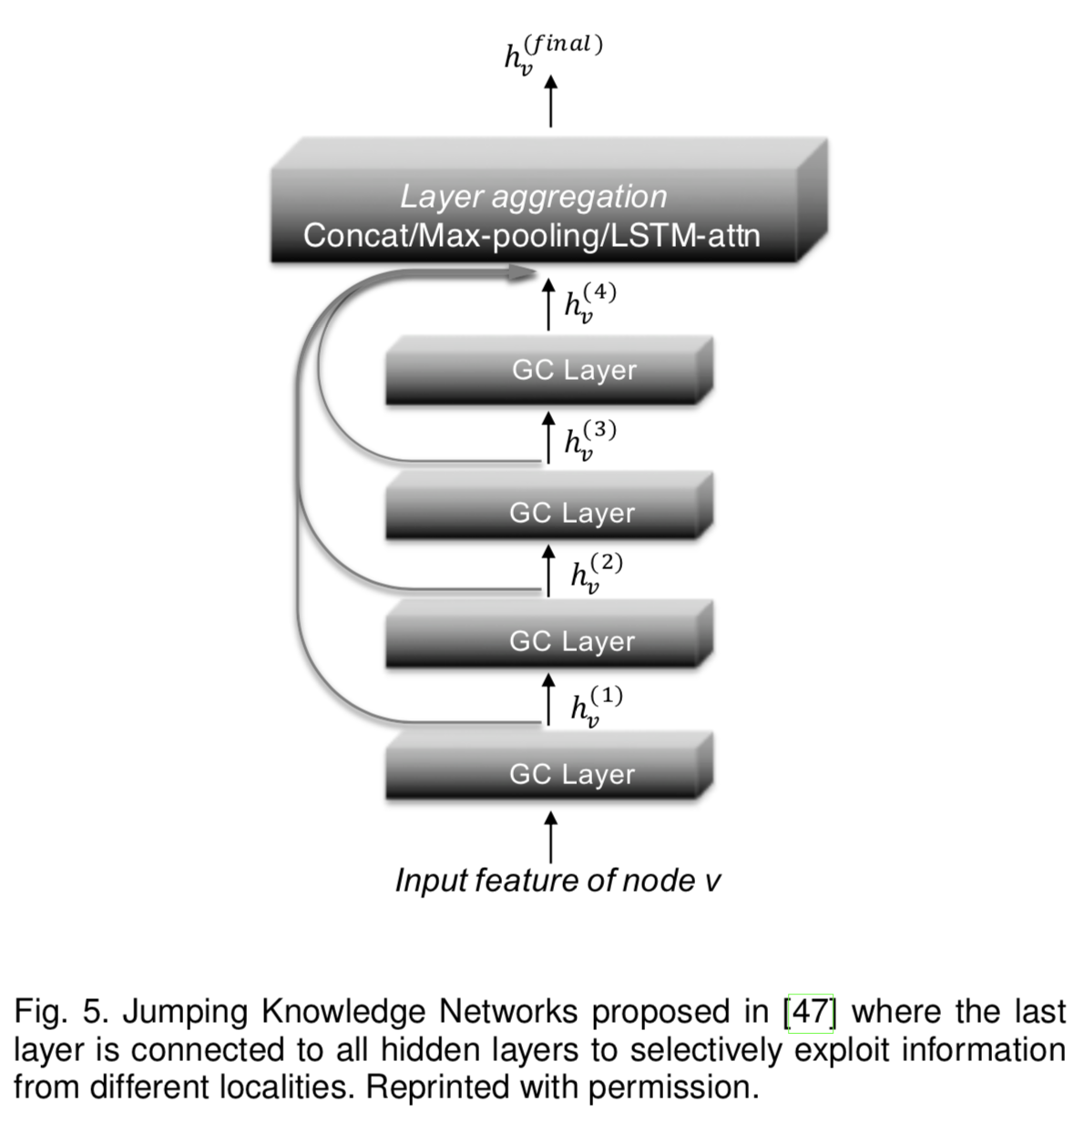
Graph kernels
Jump networks
Residual Connetion
Selective for different
orders information

Slide 14
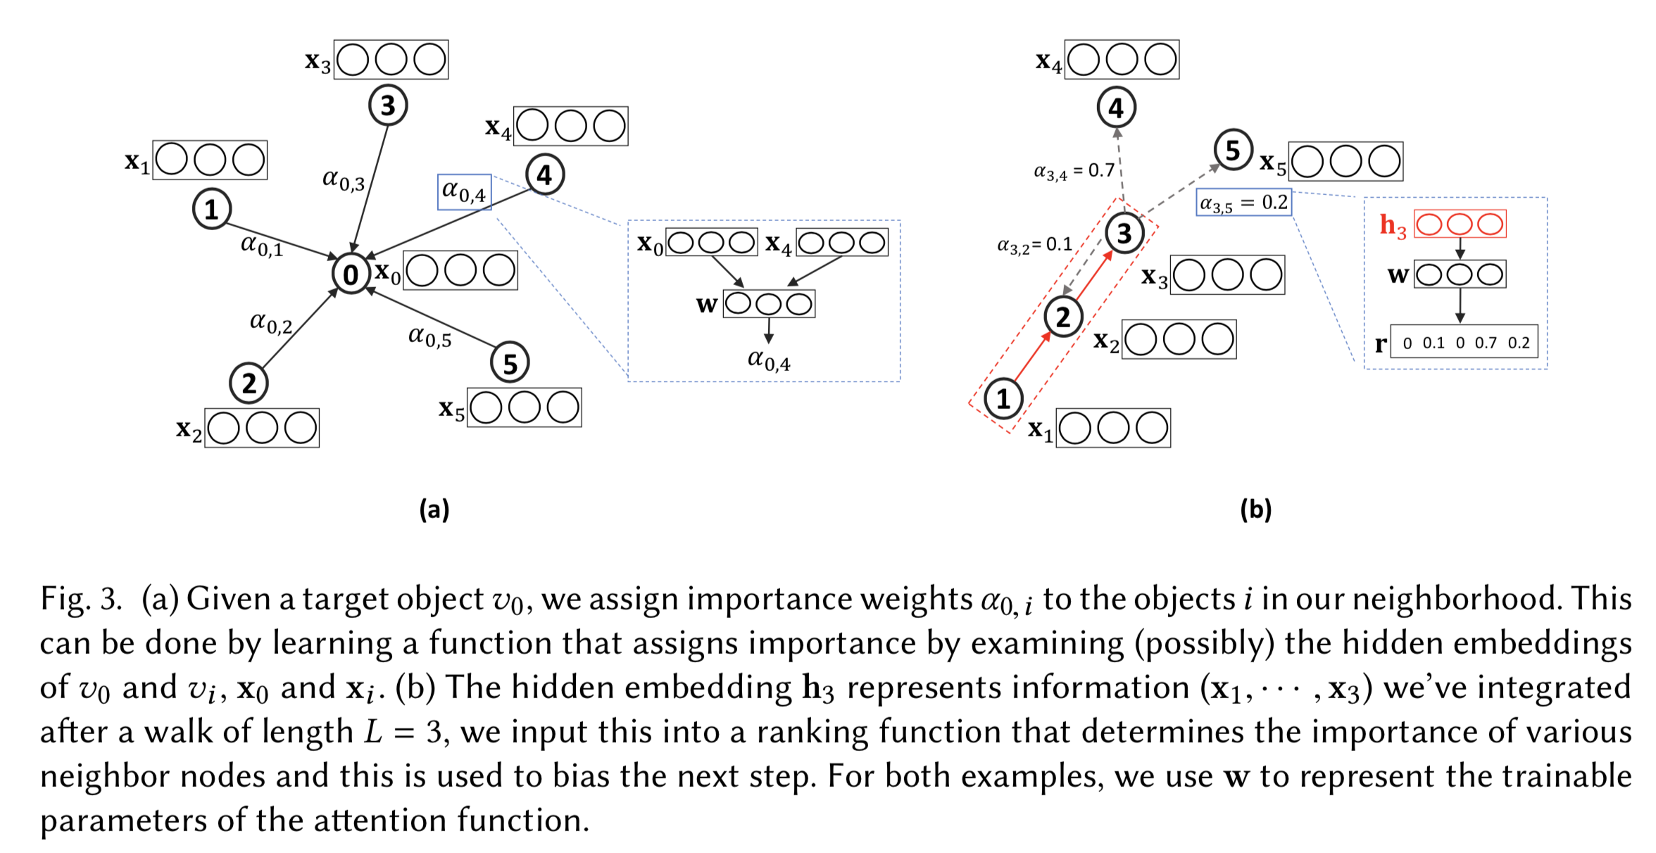
Attention based
Attention is then defined as a function f :Rh →Rk that maps an input hidden vector f (ht ) = r_(t+1) to a k-dimensional rank vector that tells us which of the k types of nodes we should prioritize for our next step.
attention based walk

Slide 15
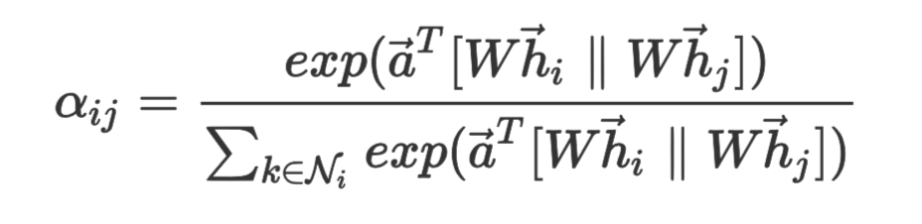
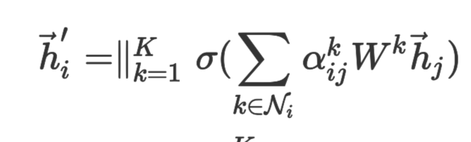
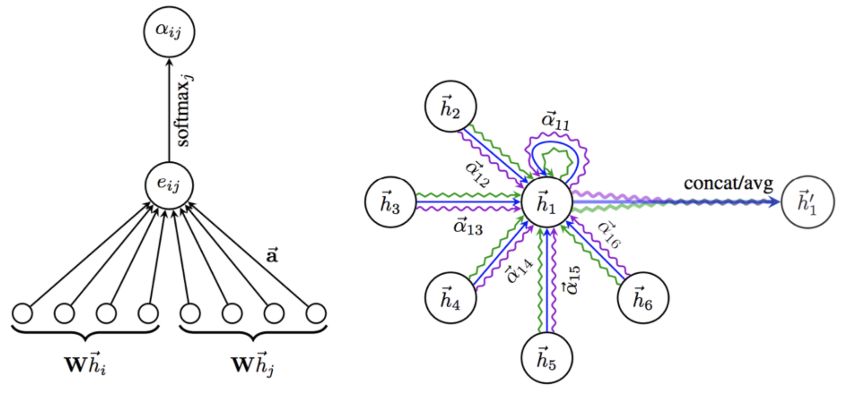
Attention based
Graph attention networks

Slide 16
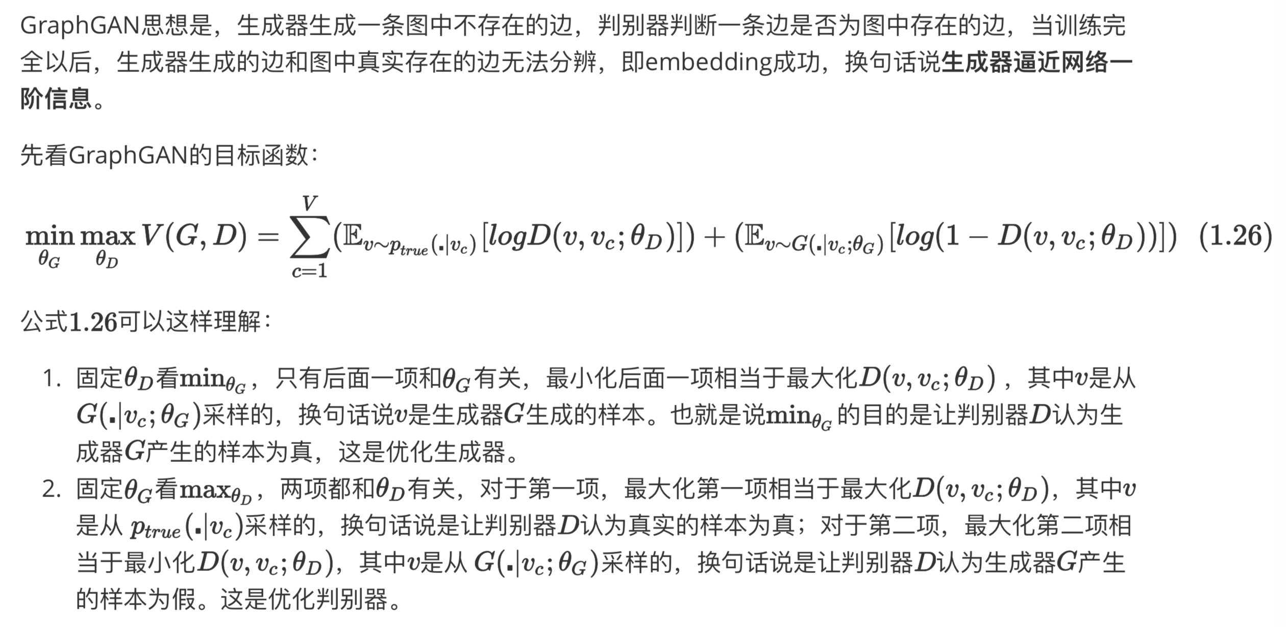
Others
Adversarial training

Slide 17
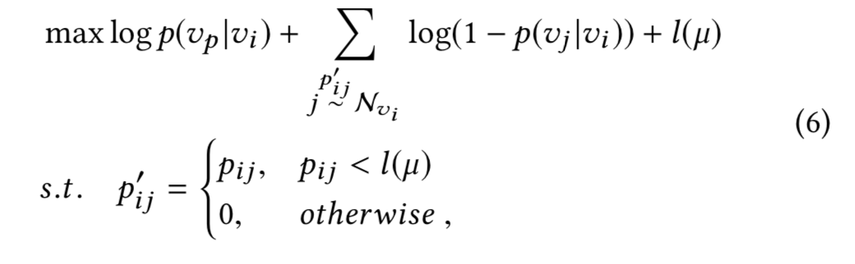
Others
Self-paced learning
from easy samples to hard samples

